Slide 1
How do all of these pieces work together when a designer creates something?
Notes:
How do all of these pieces work together when a designer creates something?
Right now, many of you still see the Elements of Design and the Principles of Desing as separate lessons rather than a connected system.

Slide 2

Mastering the Principles
Elements + Principles
Notes:
So far, we’ve learned the ingredients (elements) and the recipes (principles). Today, we’ll see how real designers use both together.
The difference between an amateur design and a professional one isn’t the elements—they’re the same—it’s how intentionally the principles guide them.
By the end, you’ll be able to analyze an ad and name which elements and principles are driving it.
GIF From
Pingu Baking GIF - Pingu Baking Cooking - Discover & Share GIFs
https://tenor.com/view/pingu-baking-cooking-bake-baker-gif-16924732

Slide 3
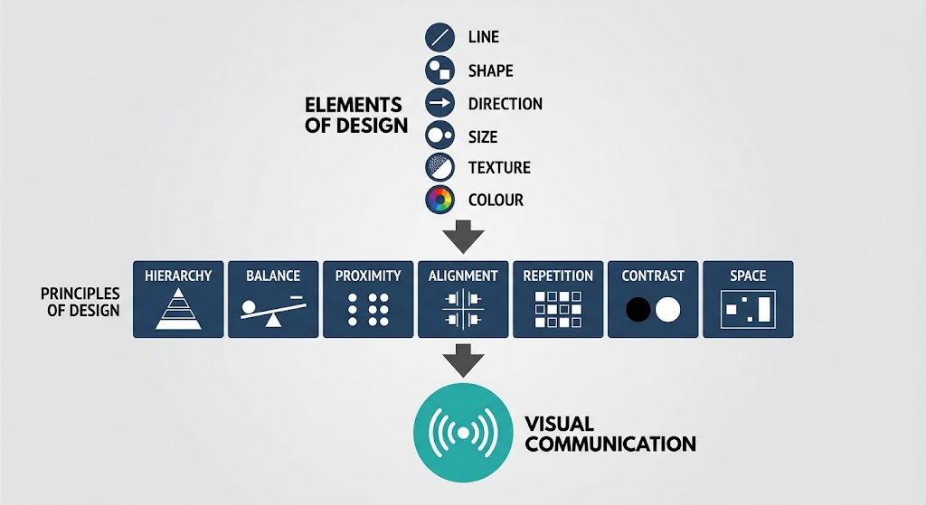
Everything Works Together
Notes:
To this point, we have studied both the Elements and Principles of Design.
It can be tempting to think of these as separate topics, but professional designers rarely think about them individually.
The Elements of Design are the building blocks.
The Principles of Design are the ways we organize those building blocks.
Think of it this way:
The Elements are your ingredients.
The Principles are your recipe.
Neither can work effectively without the other.
For example:
Colour can create contrast.
Size can create hierarchy.
Lines can create direction.
Shapes can help establish balance.
Texture can create emphasis.
Space can strengthen proximity and organization.
Great design happens when multiple elements and principles work together to communicate a message.

Slide 4
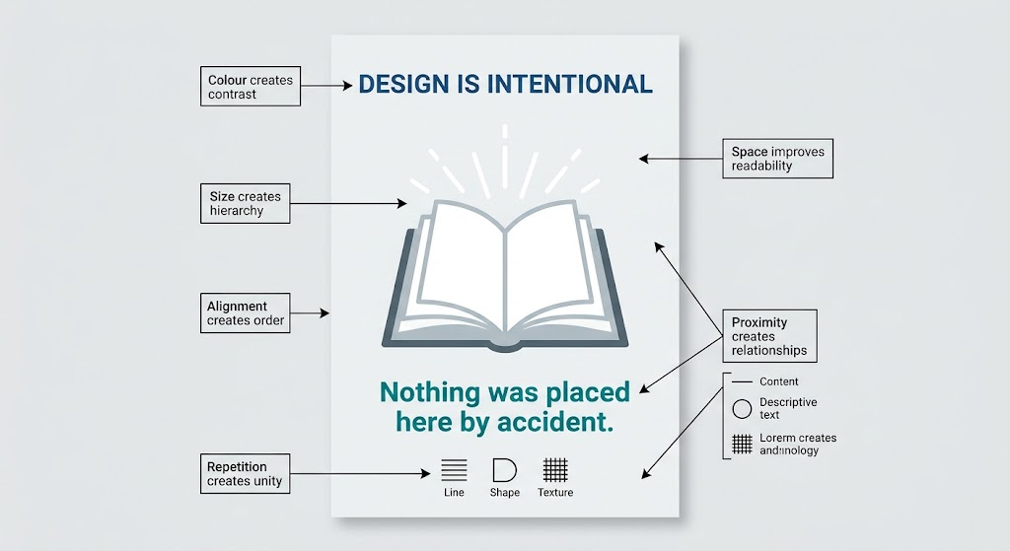
Design Is Intentional
Notes:
The most important lesson from all of these presentations is that design is intentional.
Every colour has a purpose.
Every font size has a purpose.
Every alignment choice has a purpose.
Every empty space has a purpose.
Strong designers do not simply make things look attractive.
They make deliberate choices that help audiences understand information and achieve a communication goal.
That idea connects everything we have learned about both the Elements and Principles of Design.
These past few weeks have created a bridge between the Elements of Design and the Principles of Design
Everything reinforces that Hierarchy sits at the centre of visual communication, while the other principles and the six elements are tools used to build that hierarchy and communicate effectively to an audience.

Slide 5
Design is Problem Solving
A designer must answer:
Who is the audience?
What is the message?
What action should the audience take?
What information is most important?
How can design support communication?
Audience
Message
Design Decisions
Communication
Notes:
Many people think graphic design is about making things look attractive.
Professional designers know that design is actually problem solving.
Imagine:
A concert poster
A warning sign
A product advertisement
Each has a different audience and a different goal.
Before choosing colours, fonts, or layouts, designers must first understand what problem needs to be solved.
Everything that follows should support communication.

Slide 6


GOOD OR BAD?
http://www.itsnicethat.com/articles/designing-london-2012-logo
Notes:
What do you think of this?
Good or Bad
$625,000
Probably the Olympic emblem to spark the biggest controversy in the history of the Olympic games is the one produced for London in 2012. The abstract logo was intended to be fun and edgy, created by Wolff Olins to convey the vibrancy of London as a city.
However, most people felt the emblem didn’t represent London at all.
Some people even said that the shapes represented characters from the Simpsons, with Lisa Simpson depicted in two abstract shapes on the right.
Ultimately, this logo felt rushed and inauthentic, which led it to become one of the biggest failures in Summer Games logo history.
Info from
The Best And Worst Olympic Logos From 1896 To Today
https://fabrikbrands.com/branding-matters/logofile/the-best-and-worst-olympic-logos-from-1896-to-today/

Slide 7
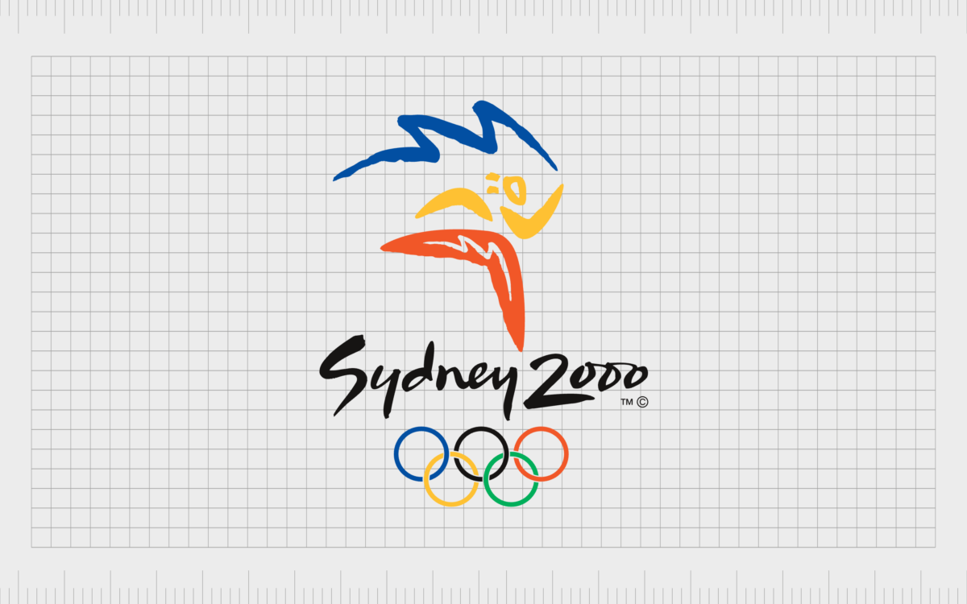
Notes:
Sydney 2000
Similar in a lot of ways to the logo design created for Barcelona in 1992, the Sydney Olympic emblem is a simple, abstract image brimming with color and life. The design is bold and energetic, with a number of meaningful components.
The figure in the design is made up of three boomerangs, a common symbol associated with Australia.
The colors in the design also symbolize various aspects of the Australian landscape, from orange (rocks and earth) to the yellow of the sun and the blue of the sea and sky. The blue-ribbon element looks a little like the top of the Sydney Opera House too.
Info From
The Best And Worst Olympic Logos From 1896 To Today
https://fabrikbrands.com/branding-matters/logofile/the-best-and-worst-olympic-logos-from-1896-to-today/

Slide 8
The Synthesis
How the elements actively build the principles

Slide 9
Elements of Design
Line:
Shape:
Direction:
Size:
Texture:
Colour:
A path between two points
A two-dimensional enclosed space
The orientation or movement of elements
The relative scale of elements
The surface quality of an object
The perception of light reflected from surfaces

Slide 10
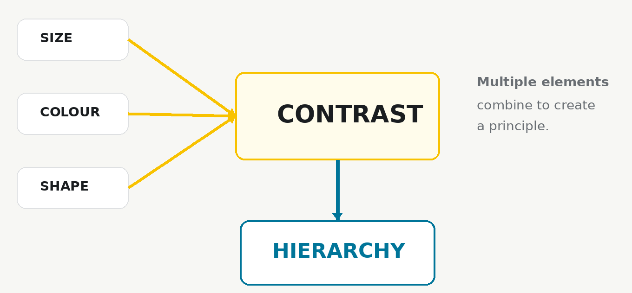
Elements Create Principles
Notes:
The elements (line, shape, size) actively build the principles (balance, alignment, contrast). They do not exist separately.
Up to this point we have basically learned elements and principles as separate lists.
In reality, principles are built from elements.
For example:
Contrast is not something you can place onto a page.
Contrast must be created using:
Colour differences
Size differences
Shape differences
Texture differences
The elements create the principles.

Slide 11
One Element, Many Principles
Notes:
A single design decision can support multiple principles at once.
Professional designers are rarely thinking:
"Now I will apply balance."
Instead they make a design decision.
That decision often affects multiple principles simultaneously.
This is one of the biggest mindset shifts from beginner to designer.
Here we have one shape = element
But it can apply to many principles

Slide 12
One Element, Many Principles
Size creates Hierarchy
Notes:
A single design decision can support multiple principles at once.
Professional designers are rarely thinking:
"Now I will apply balance."
Instead they make a design decision.
That decision often affects multiple principles simultaneously.
This is one of the biggest mindset shifts from beginner to designer.
Here we have one shape = element
But it can apply to many principles

Slide 13
One Element, Many Principles
Colour gives Contrast
Notes:
A single design decision can support multiple principles at once.
Professional designers are rarely thinking:
"Now I will apply balance."
Instead they make a design decision.
That decision often affects multiple principles simultaneously.
This is one of the biggest mindset shifts from beginner to designer.
Here we have one shape = element
But it can apply to many principles

Slide 14
One Element, Many Principles
Placement gives Balance
Notes:
A single design decision can support multiple principles at once.
Professional designers are rarely thinking:
"Now I will apply balance."
Instead they make a design decision.
That decision often affects multiple principles simultaneously.
This is one of the biggest mindset shifts from beginner to designer.
Here we have one shape = element
But it can apply to many principles

Slide 15
One Element, Many Principles
Position defines Alignment
Notes:
A single design decision can support multiple principles at once.
Professional designers are rarely thinking:
"Now I will apply balance."
Instead they make a design decision.
That decision often affects multiple principles simultaneously.
This is one of the biggest mindset shifts from beginner to designer.
Here we have one shape = element
But it can apply to many principles

Slide 16
One Element, Many Principles
Position defines Alignment
Notes:
A single design decision can support multiple principles at once.
Professional designers are rarely thinking:
"Now I will apply balance."
Instead they make a design decision.
That decision often affects multiple principles simultaneously.
This is one of the biggest mindset shifts from beginner to designer.
Here we have one shape = element
But it can apply to many principles

Slide 17
One Element, Many Principles
Position defines Alignment
Notes:
A single design decision can support multiple principles at once.
Professional designers are rarely thinking:
"Now I will apply balance."
Instead they make a design decision.
That decision often affects multiple principles simultaneously.
This is one of the biggest mindset shifts from beginner to designer.
Here we have one shape = element
But it can apply to many principles

Slide 18
The Elements Working Together
Rarely Used Alone
Designs often combine:
Line
Shape
Direction
Size
Texture
Colour
Working together to create:
Hierarchy
Emotion
Focus
Meaning
Notes:
When students first learn design theory, they often identify elements individually.
In professional design, elements rarely appear alone.
The power comes from their combination.

Slide 19
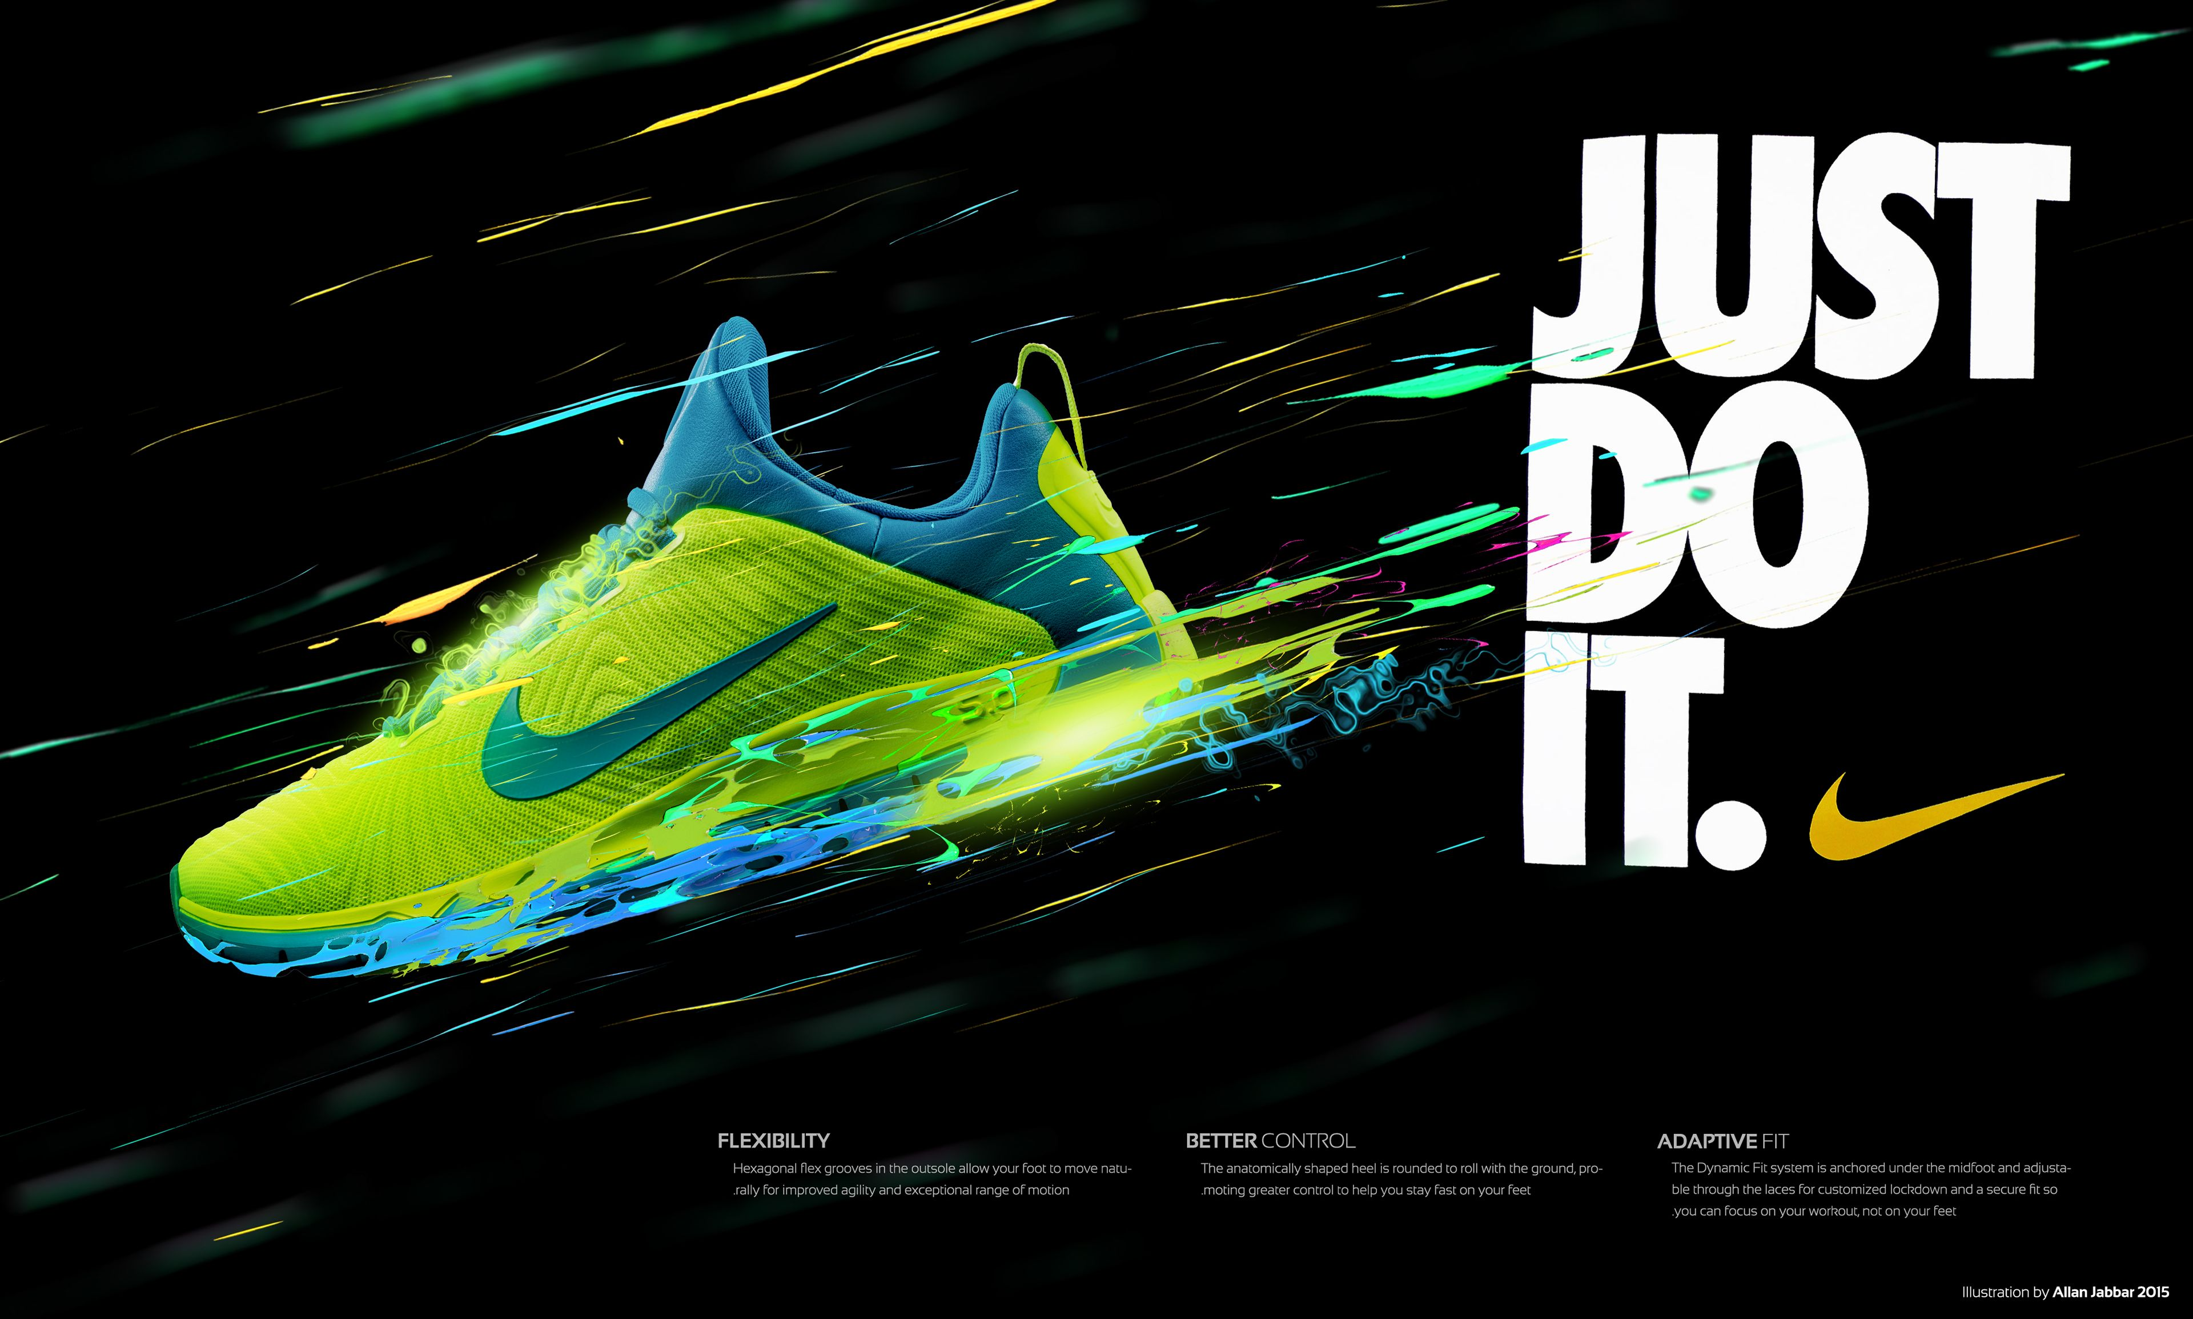
The Elements Working Together
Notes:
Consider a Nike advertisement.
You may see:
Large type (Size)
Diagonal movement (Direction)
Strong colour contrast (Colour)
Geometric blocking (Shape)
The power comes from their combination.
Image from: https://sl.bing.net/dMufRlKnsiq

Slide 20
The Hierarchy Formula
Hierarchy is built using:
Size
Colour
Contrast
Space
Direction
Hierarchy is not a separate technique.
Hierarchy is the result of design decisions.
Notes:
Hierarchy doesn't magically appear.
Designers build hierarchy using elements and principles.
Every hierarchy you see is constructed.
Visual
Hierarchy at center
Connected to:
Size
Contrast
Space
Colour
Direction

Slide 21
Principles of Design
Balance:
Proximity:
Alignment:
Repetition:
Contrast:
Space:
Does the page feel stable or lopsided?
Are related things close together?
Do edges line up along an invisible grid?
Are you creating unity with consistent choices?
What stands out first? Why?
Is there breathing room, or is it crammed?

Slide 22
One Principle, Many Elements
CONTRAST
Notes:
Contrast can be created in many different ways.
This reinforces that principles depend on elements.

Slide 23
One Principle, Many Elements
CONTRAST
Contrast through size
Notes:
Contrast can be created in many different ways.
This reinforces that principles depend on elements.

Slide 24
One Principle, Many Elements
CONTRAST
Contrast through Colour
Notes:
Contrast can be created in many different ways.
This reinforces that principles depend on elements.

Slide 25

One Principle, Many Elements
CONTRAST
Contrast through Texture
Notes:
Contrast can be created in many different ways.
This reinforces that principles depend on elements.

Slide 26
One Principle, Many Elements
CONTRAST
Contrast through Shape
Notes:
Contrast can be created in many different ways.
This reinforces that principles depend on elements.

Slide 27

One Advertisement. Six Principles
White Space
Balance
Alignment
Can you find:
Balance
Proximity
Alignment
Repetition
Contrast
Space
Contrast
Repetition
Proximity
Notes:
We often learn principles independently.
In reality: All six appear simultaneously.
Can you find:
✅ Balance
✅ Proximity
✅ Alignment
✅ Repetition – font and colour
✅ Contrast – yellow and red
✅ Space
Visual
One well-designed advertisement
Callouts identifying each principle.
Image From Zesto – Food Delivery Brand Campaign :: Behance
https://www.behance.net/gallery/243368997/Zesto-Food-Delivery-Brand-Campaign?utm_source=chatgpt.com

Slide 28
Principles Don't Work Alone
Contrast creates attention
Space creates emphasis
Alignment creates order
Proximity creates relationships
Repetition creates unity
Balance creates stability
Notes:
The principles support one another.
Removing one weakens the system.

Slide 29
Structural Breakdown
Notes:
Projecting clean, excellent designs and mapping out their exact skeleton tells me the lecture should be design critique and reverse engineering.
This should become nearly half the presentation.

Slide 30
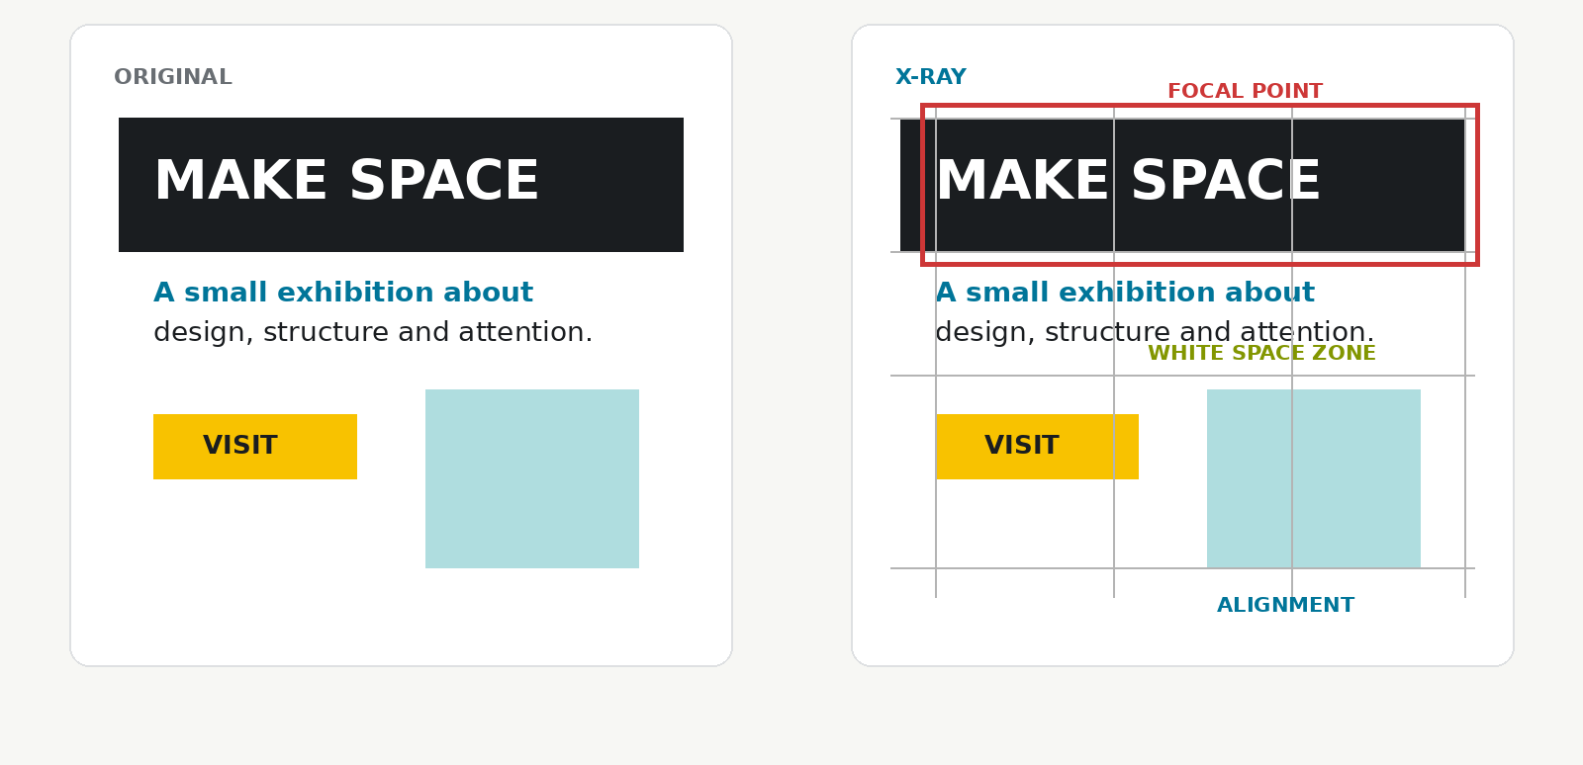
Design X-Ray
Visual
Show:
Advertisement
Poster
Website
Overlay annotations showing:
Grid lines
Focal point
Alignment lines
Contrast locations
White space zones
Notes:
Professional designers develop the ability to see structure.
Most audiences see the final design.
Designers see the skeleton.
Today we are going to learn how to see the skeleton.

Slide 31
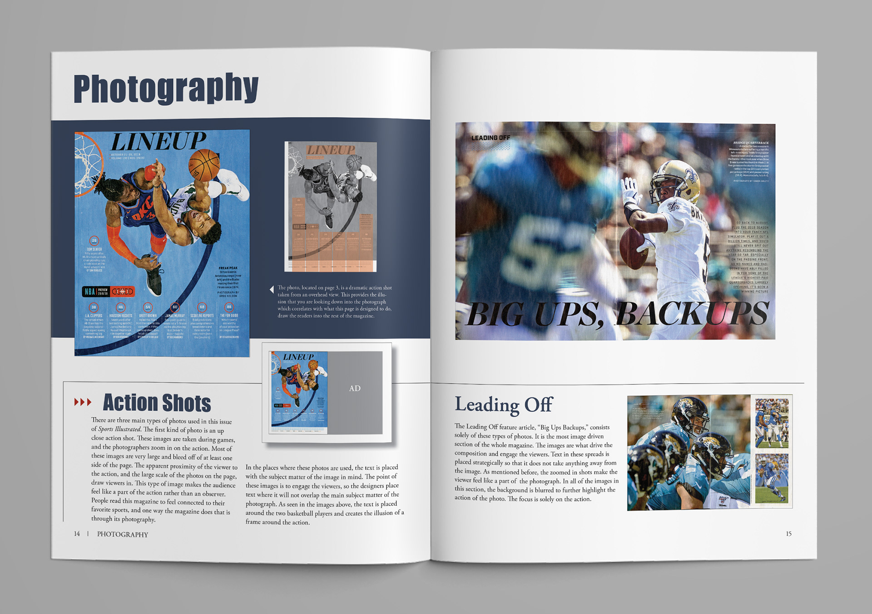
Design X-Ray
White Space
Visual
Show:
Advertisement
Poster
Website
Overlay annotations showing:
Grid lines
Focal point
Alignment lines
Contrast locations
White space zones
Notes:
Professional designers develop the ability to see structure.
Most audiences see the final design.
Designers see the skeleton.
Today we are going to learn how to see the skeleton.
POINT OUT
Grid lines
Focal point
Alignment lines
Contrast locations
White space zones

Slide 32
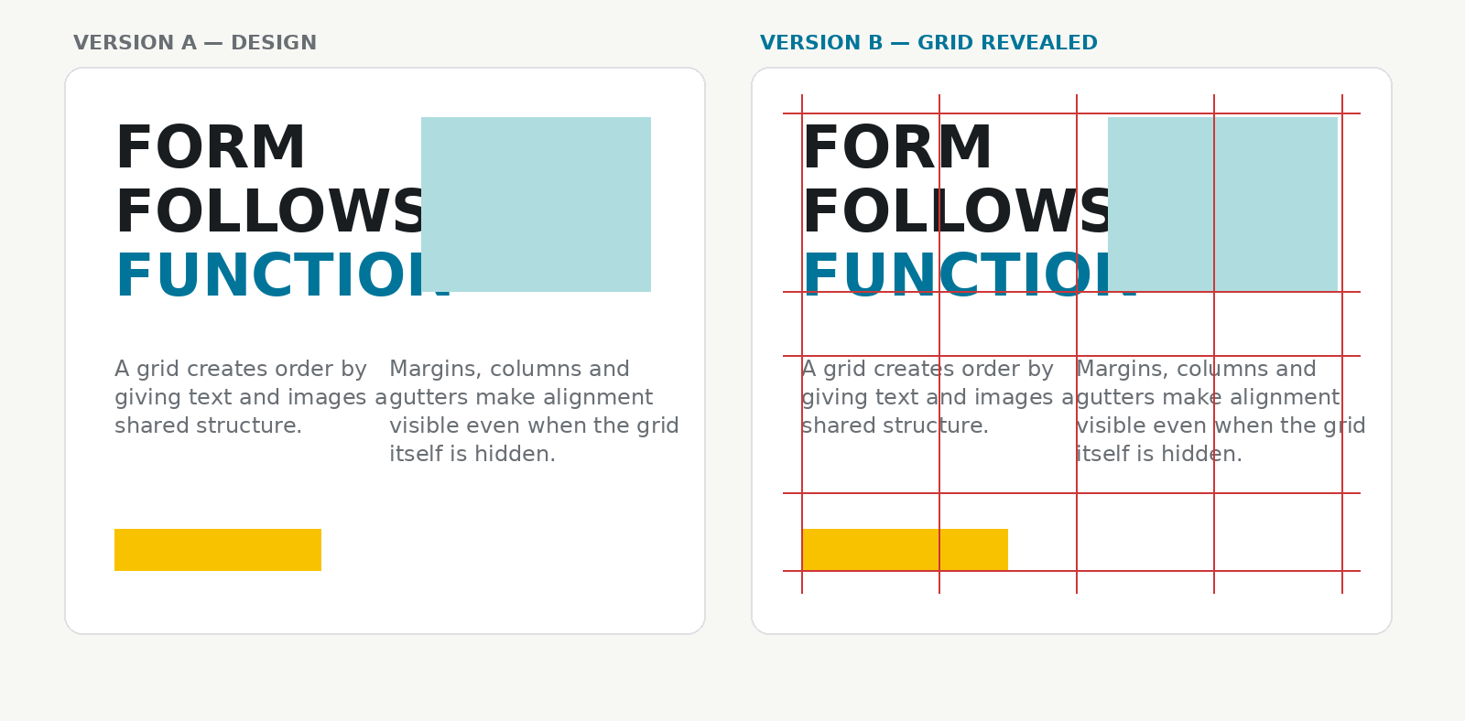
Find the Grid
Show a magazine spread.
Version A
Actual design
Version B
Same design with grid overlay.
Notes:
Students are often shocked to discover how much structure exists underneath a design.
This is a perfect bridge back to Alignment.

Slide 33
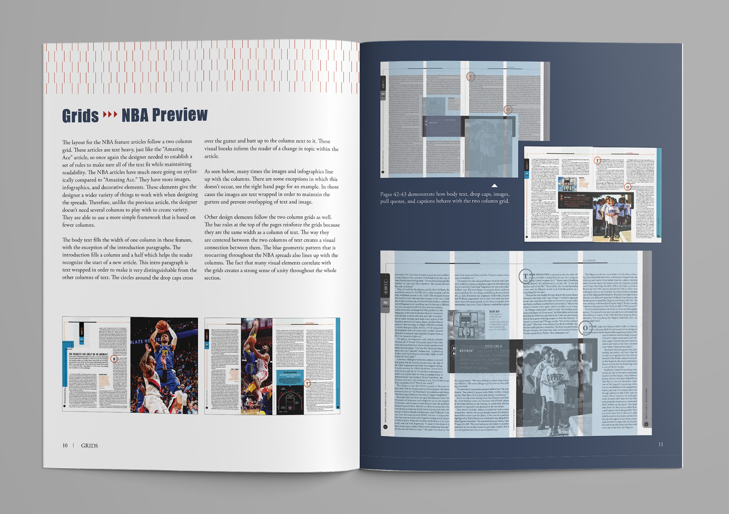
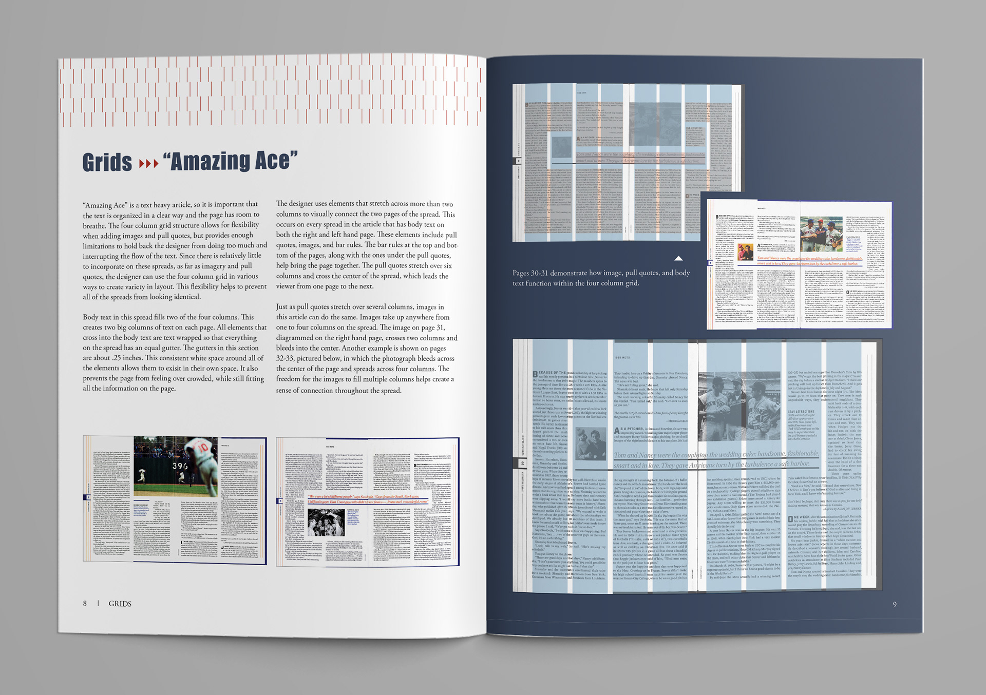
Find the Grid
Show a magazine spread.
Version A
Actual design
Version B
Same design with grid overlay.
Notes:
Students are often shocked to discover how much structure exists underneath a design.
This is a perfect bridge back to Alignment.

Slide 34
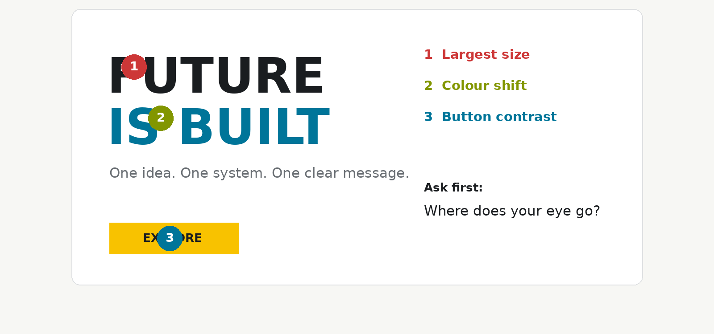
Locate the Contrast Points
Show a design.
Notes:
Ask students:
Where does your eye go first?
Second?
Third?
Then reveal annotations.
Contrast creates visual magnets.
Designers intentionally place them.

Slide 35
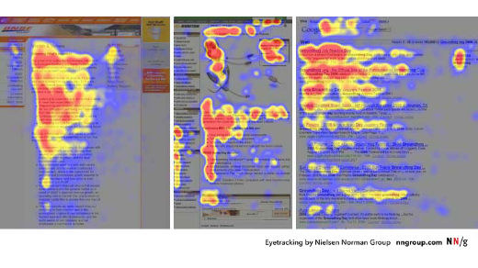
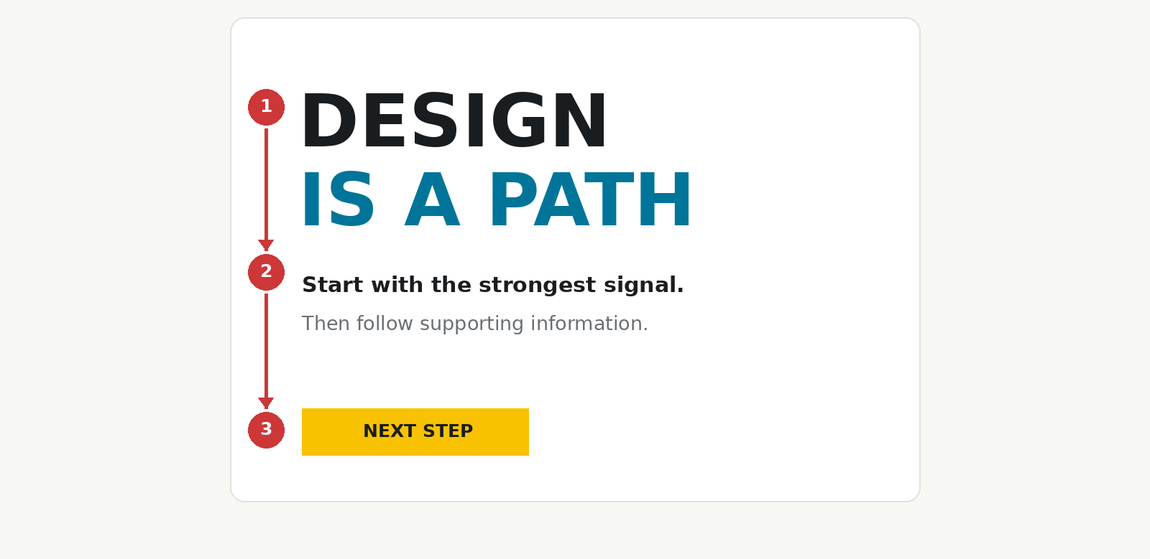
Follow the Reading Path
Ask students:
Where does your eye go first?
Second?
Third?
Then reveal annotations.
Speaker Notes
Contrast creates visual magnets.
Designers intentionally place them.
Notes:
Designers create a reading experience.
They control where the audience travels next.
Ask students:
Where does your eye go first?
Second?
Third?
Then reveal annotations.
Contrast creates visual magnets.
Designers intentionally place them.
Connect directly back to Hierarchy.

Slide 36
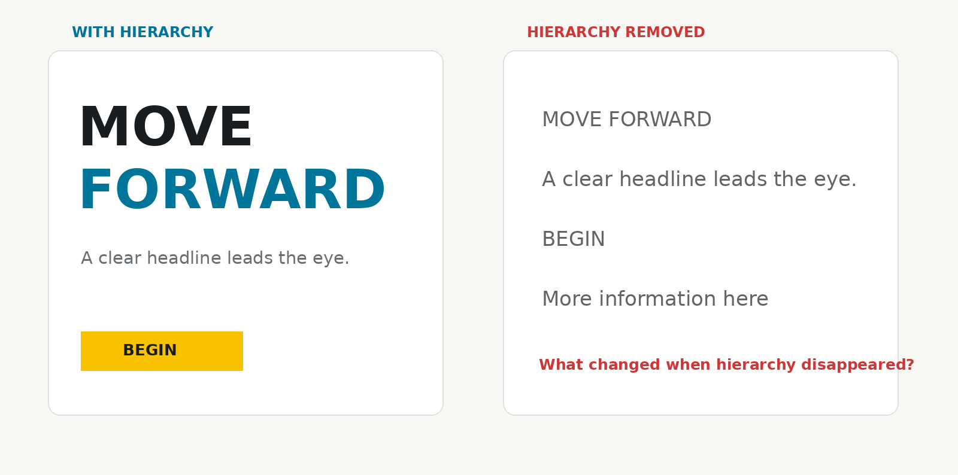
Remove One Principle Activity
Show a strong advertisement.
Notes:
What happens if we remove:
Contrast?
Alignment?
Space?
Students begin seeing how important each principle is.

Slide 37


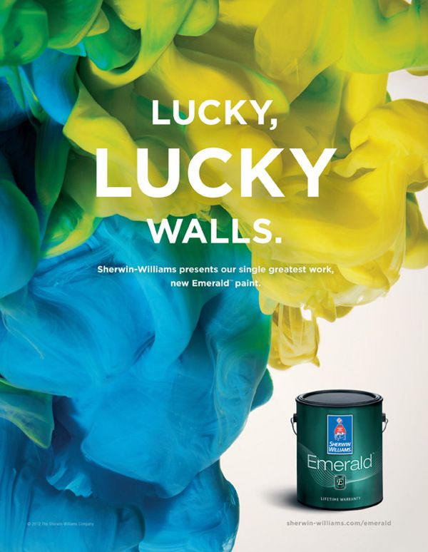
Elements + Principles Together
Elements = tools
Principles = rules
Pro design = intentional combos
Notes:
Elements alone don’t mean much. Principles direct them.
“Notice: an element on its own doesn’t mean much. A line is just a line—but when you apply principles, it becomes a guide for the eye.”
“A colour is just red—but with principles like contrast and repetition, it becomes a Coca-Cola campaign.”
“Professional design = intentional combination.”
Visuals: One ad annotated with both elements (colour, line) + principles (contrast, proximity).
Colour + contrast = Coca-Cola campaign.
Line + direction = Nike ad.
Ask: How do elements + principles interact here?
Images from
https://sl.bing.net/hDM993JyMzk
https://sl.bing.net/fLFed3UiXKe
https://sl.bing.net/jO5frKUfJAW

Slide 38
Why Does It Work?
When a design succeeds:
The message is clear.
The hierarchy is strong.
Elements support principles.
The audience understands the message.
Notes:
This is where students connect theory to outcomes.
The goal is never: "Use contrast."
The goal is: "Help the audience understand."

Slide 39
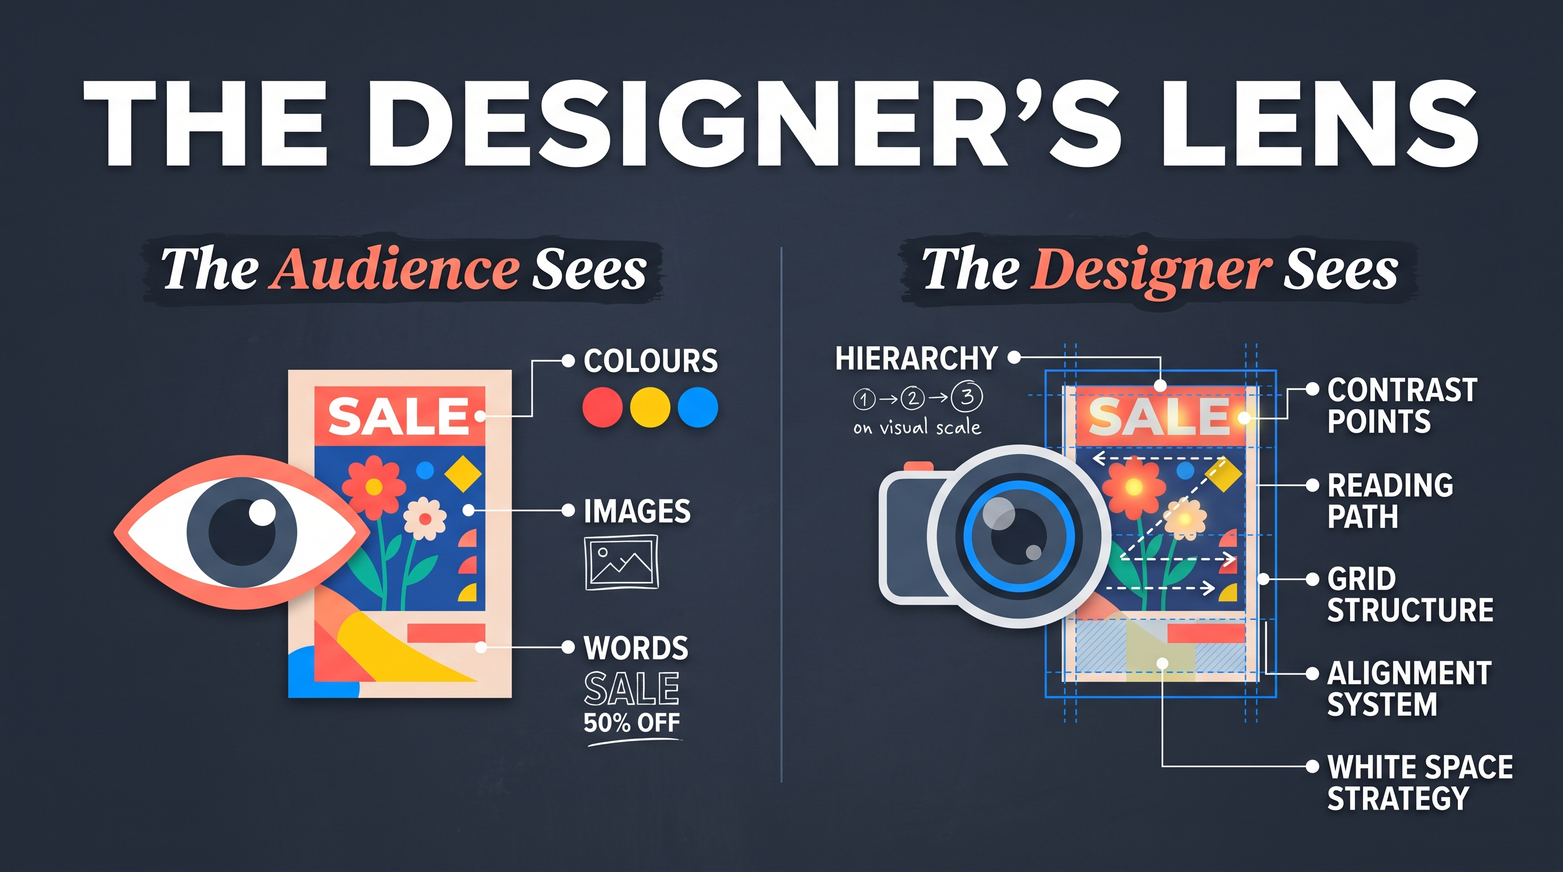
The Designer's Lens
Notes:
This is essentially what the entire presentation is teaching.
To see a design differently.
Audience sees:
Colours
Images
Words
Designer sees:
Hierarchy
Contrast points
Reading path
Grid structure
Alignment system
White space strategy

Slide 40
Design Critique Framework
Elements
  What visual building blocks are used?
Principles
  How are those elements organized?
Audience
  Who is this for?
Message
  What is it trying to communicate?
Effectiveness
  Did it work?
Notes:
This becomes a tool students can use for every future critique.

Slide 41
The Designer's Checklist
Before finalizing a design:
Is the message clear?
Is the hierarchy obvious?
Is the layout balanced?
Does alignment create structure?
Does contrast create focus?
Does space improve understanding?

Slide 42
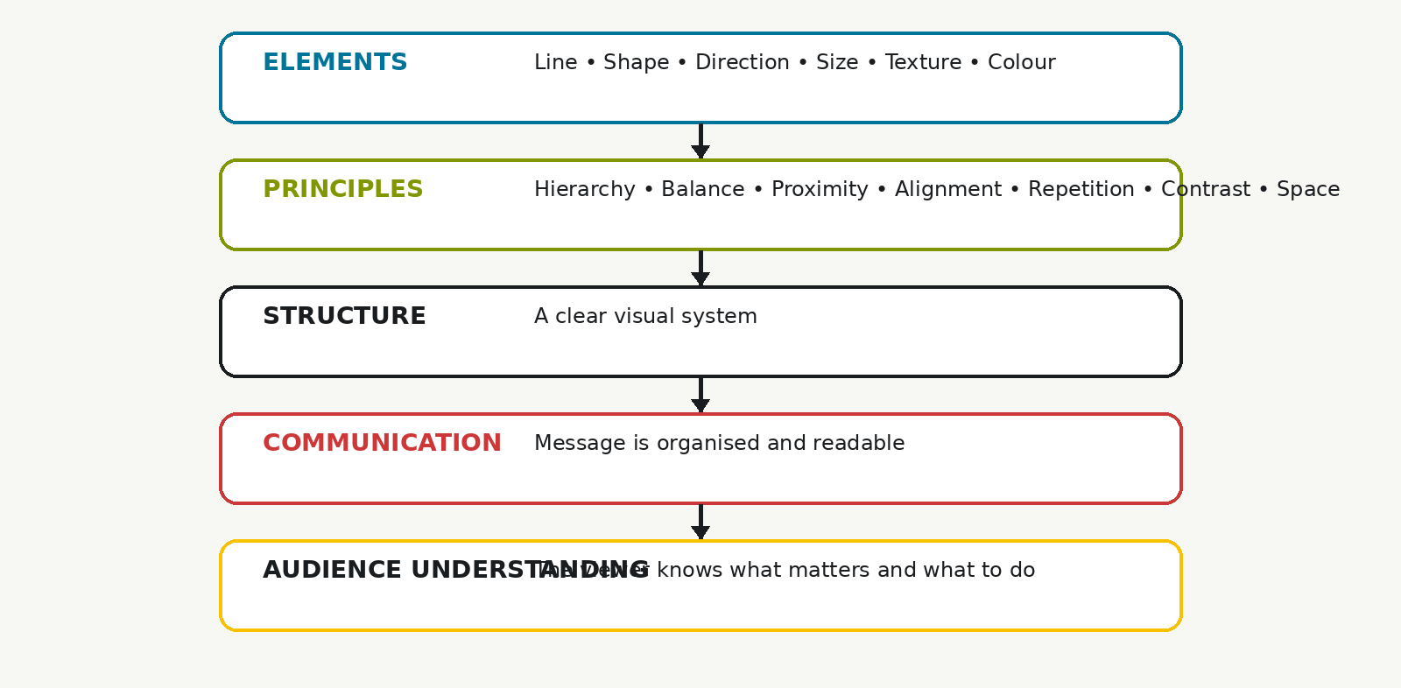
Everything Works Together
Visual Framework:
ELEMENTS
(Line, Shape, Direction,
Size, Texture, Colour)
↓
PRINCIPLES
(Hierarchy, Balance,
Proximity, Alignment,
Repetition, Contrast,
Space)
↓
STRUCTURE
↓
COMMUNICATION
↓
AUDIENCE UNDERSTANDING
Notes:
The Elements of Design are the building materials.
The Principles of Design are the organizational systems.
Excellent designers do not think about them separately.
They use both simultaneously to create hierarchy, structure information, guide attention, and communicate a message effectively.

Slide 43
Everything Works Together
Notes:
To this point, we have studied both the Elements and Principles of Design.
It can be tempting to think of these as separate topics, but professional designers rarely think about them individually.
The Elements of Design are the building blocks.
The Principles of Design are the ways we organize those building blocks.
Think of it this way:
The Elements are your ingredients.
The Principles are your recipe.
Neither can work effectively without the other.
For example:
Colour can create contrast.
Size can create hierarchy.
Lines can create direction.
Shapes can help establish balance.
Texture can create emphasis.
Space can strengthen proximity and organization.
Great design happens when multiple elements and principles work together to communicate a message.

Slide 44
Design Is Intentional
Notes:
The most important lesson from all of these presentations is that design is intentional.
Every colour has a purpose.
Every font size has a purpose.
Every alignment choice has a purpose.
Every empty space has a purpose.
Strong designers do not simply make things look attractive.
They make deliberate choices that help audiences understand information and achieve a communication goal.
That idea connects everything we have learned about both the Elements and Principles of Design.
These past few weeks have created a bridge between the Elements of Design and the Principles of Design
Everything reinforces that Hierarchy sits at the centre of visual communication, while the other principles and the six elements are tools used to build that hierarchy and communicate effectively to an audience.

